Slide 1
Project De-Vine Environmental Trust Community led conservation in action
Summary presentation of how Project De-Vine started, its aims, methods of working and reporting, and many other aspects.
Last updated 16th August 2021
Notes:
Kia ora tatou
My name is Neil Clifton, I’m chair of Project De-Vine, a charitable conservation trust that has its origins in Golden Bay.
This is a talk abut how the trust started and has evolved.

Slide 2
Project De-Vine Environmental Trust
Fostering native ecosystems in Golden Bay and the Top of the South

Slide 3
Notes:
Project de-Vine manages its control programme according to management units.
These are the units of eastern Golden Bay and Riwaka to Marahau (the borders of Abel Tasman National Park).

Slide 4
Project De-Vine - Primary Objectives
To control Banana passion vine, Old man's beard and other key invasive plants in Golden Bay.
To form a buffer zone, ‘halo’ around Abel Tasman and Kahurangi National Parks.
To be leaders in innovative and effective methods of community-led regional-scale weed control.
Notes:
Project De-Vine Primary Objectives
To control banana passion vine, old man's beard and other key invasive plants in Golden Bay, to the extent that no fruit or seed producing plants (zero-density) remain.
To form a buffer zone, “halo" around Abel Tasman and Kahurangi National Parks to assist partner organisations to keep the Parks weed free (DOC, Project Janszoon).
To be leaders in innovative and effective methods of community-led regional-scale weed control.

Slide 5
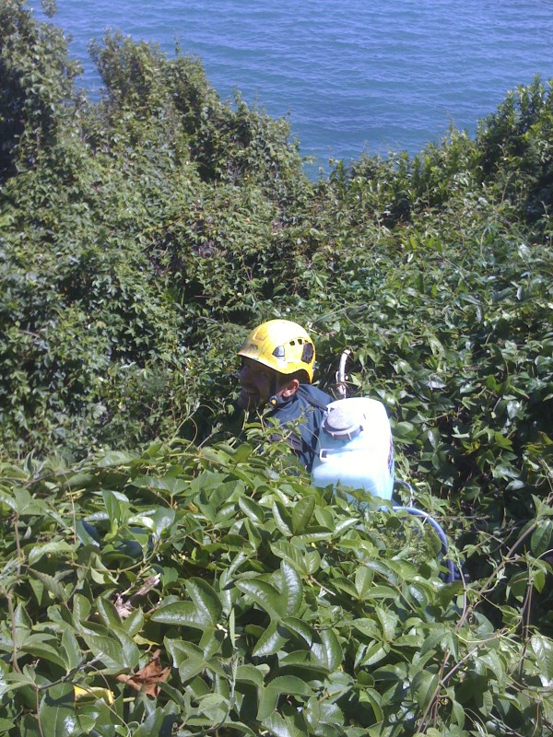
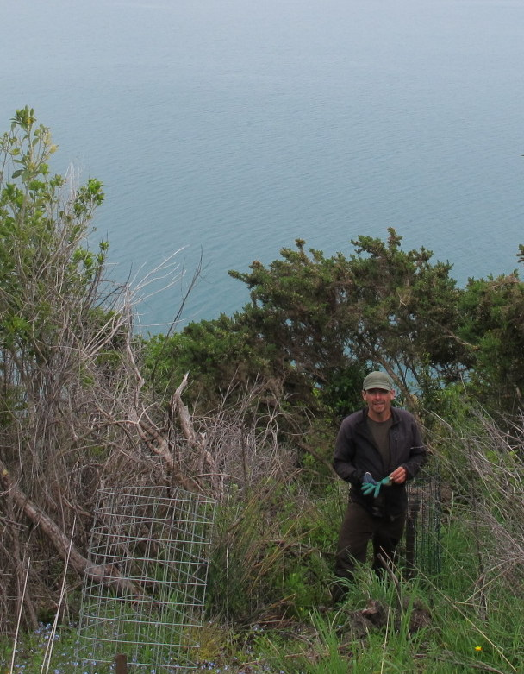
Tata Peninsula Rampant Banana passion vine - before and 3 years after – the same location - Rata trees being planted
Notes:
Tata Peninsula Before and 3 years after – same location with Rata trees being planted.

Slide 6
Flagship site: Takaka Hill
Project De-Vine has worked with New Zealand Transport Agency to control pest vines on the Takaka Hill road.
Notes:
Flagship site: Takaka Hill
Project De-Vine has worked with NZ Transit Authority to control pest vines on the Takaka Hill roadside section of SH 60.
Flagship site: Waingaro River
Sponsored by LINZ to control banana passion vines and old man’s beard

Slide 7
Key pest plants of interest
Banana passion vine - Sustained Control Pest plant in Golden Bay and Upper Riwaka
Old man’s beard - Sustained Control Pest plant in Golden Bay and Upper Riwaka
Climbing asparagus - Sustained Control Pest plant in Eastern Golden Bay – under review for all Golden Bay
Woolly nightshade - Sustained Control Pest plant for all Golden Bay
Purple and White pampas – Deleted as a control plant we continue to control it when we can
Italian / yellow jasmine - Sustained Control Pest plant in the Whole Tasman-Nelson Region
Other less common control plants eg. Ginger, Madeira vine
We submit to the reviews of the Regional Pest Management Plan

Slide 8
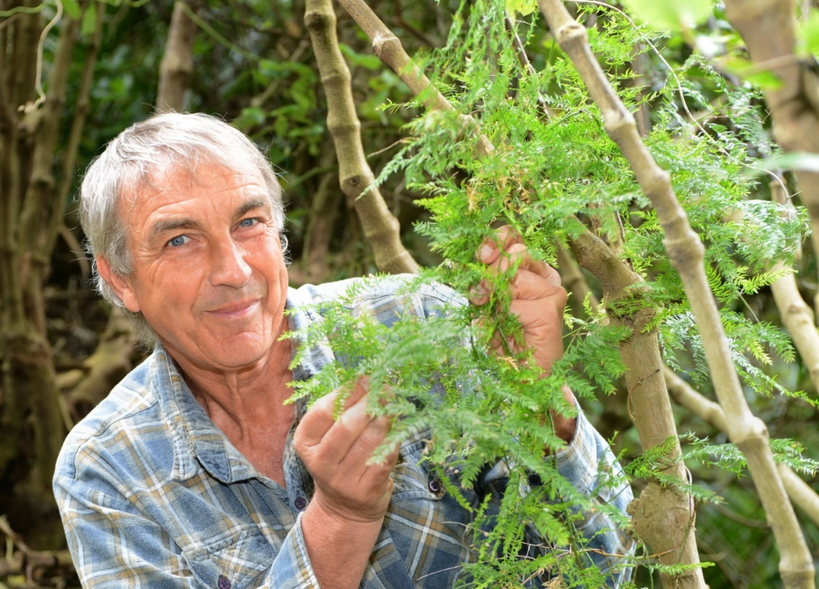
Climbing asparagus
Out of control - Waiheke Island - but was sprayed effectively
A well-established Climbing
asparagus plant wrapping
itself around a young tree.

Slide 9
Woolly nightshade

Slide 10
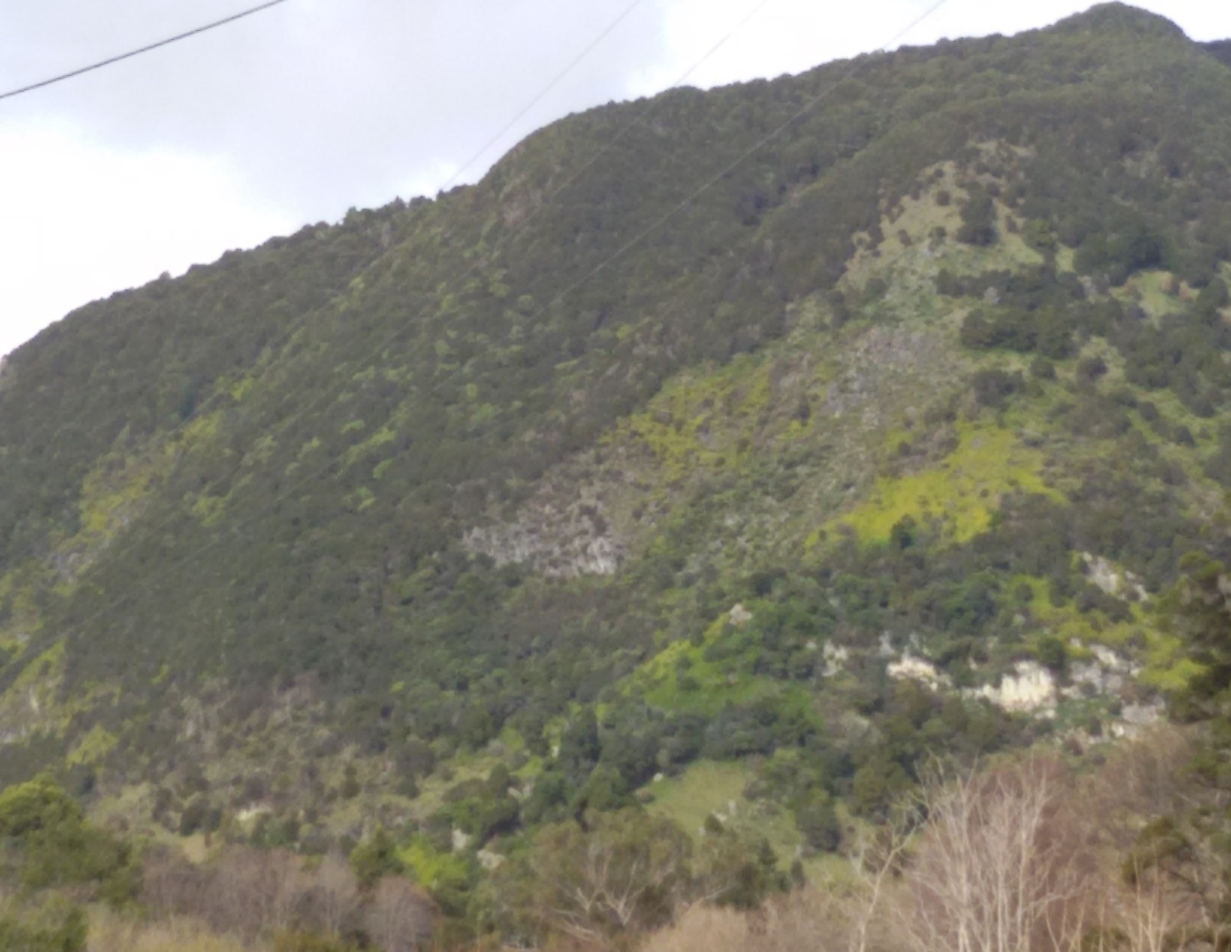
Yellow or Italian jasmine

Slide 11
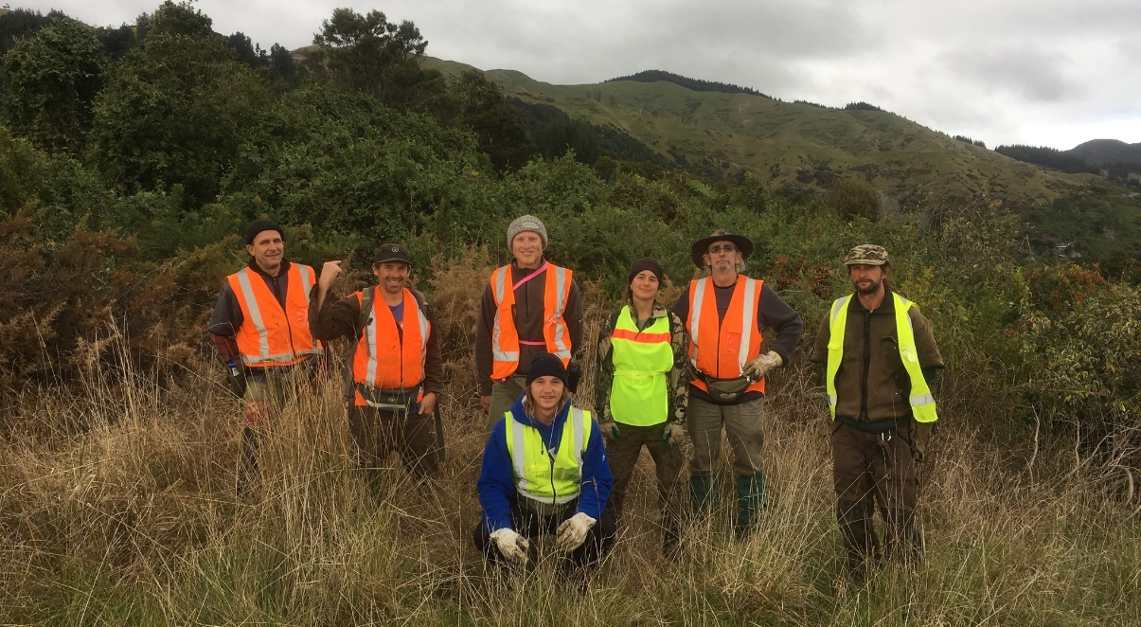
First funding
2009 / 10
Applied with 15 other properties and received funding from the DOC Biodiversity Condition fund and from the Tasman District Council.
Killed over 30,000 vines manually.
Recruited the first paid weedbusting team.
Notes:
First Funding
2009 / 10
In spite of their efforts, there still seemed to be a a never-ending number of vines on properties around them and an endless sea of eadging closer to their QEII covenant.
The local QEII representative suggested applying for help from the DOC Biodiversity Condition Fund (BCF).
They applied along with other properties & received $54,000 from the DOC Biodiversity Condition fund plus $4000 from TDC.
With this funding they killed 30,400 vines manually
Funding also enabled the recruitment of the first paid weedbusting team.

Slide 12
Further funding as a greater area is added
Over 2011 / 2013 a further 130 properties were brought under control with funding from the DOC Biodiversity Condition fund.
Since then, there have been many more grants, totalling over $2,500,000, to work towards our goals.
Effective control over large parts of Golden Bay – with over 700 properties assessed.
We have also carried out over $2,500,000 of contract work to primarily control pest plants and trees for various agencies in Golden Bay and around Riwaka to Marahau.
Notes:
As confidence grew, so did the area covered.
Over 2011 / 2013 a further 130 properties underwent assessment and control in the Clifton, Rameka and Pohara areas with funding from the DOC Biodiversity Condition fund.
Since then many more grants, totalling in excess of $1.3 million, have enabled effective control over large parts of Golden Bay

Slide 13
Recent years
Until 2016, Project De-Vine was under the umbrella of Forest and Bird
Since then it has become an independent charity – Project De-Vine Trust. We changed our name in 2019 to Project De-Vine Environmental Trust – to reflect our increasing work in planting, trapping and restoration work.
A large part of the Trust’s work is on private land.
Notes:
Recent Years
Until 2016, Project De-Vine was under the umbrella of Forest and Bird
Since then it has become an independent charity – Project De-Vine Trust
A large part of the Trust’s work is on private land.

Slide 14
Model of operation
Apply to charitable organisations & sponsors to carry out pest vine and other pest plant and tree control work throughout Golden Bay and the ‘halo’ of Abel Tasman and Kahurangi National Parks.
Provide a contract service to multiple agencies.
Contract work allows us to create a small surplus.
Surpluses allow us to start new initiatives.
Notes:
Model of operation
Apply to charitable organisations (eg. Lotteries) for funding to carry out pest vine and other plant control throughout Golden Bay and the 'Halo’ of Abel Tasman & Kahurangi National Parks
Provide a contract service to multiple agencies, TDC, DOC, Janszoon, LINZ, NZTA, QEII and landowners.
The contract work allows a ‘surplus’ (small profit).
The surplus allows Project De-Vine to cover overheads and prepare initiatives that are not able to be funded out of charitable grants e.g. It can take up to 2 years from carrying out an unfunded assessment before receiving funding for control work.

Slide 15
Model of Operation
This kind of work is different from that of a public agency
Dependent on local community and land-owner relationships
Funding can be ad hoc.
It relies on voluntary commitment.
Notes:
Model of Operation (2)
This kind of work is different from that of a public agency –
Because it is operating primarily on private land, it is dependent on local community and land owner relationships (i.e. PDVT doesn’t have a statutory mandate).
Funding can be quite ad hoc requiring a very good awareness of funders and their rules. A large amount of ongoing effort goes into winning resources and managing continuity of work delivery.
It relies on a very high degree of voluntary commitment.

Slide 16
Multiple partnerships & funders
Tasman Environmental Trust
Department of Conservation
Tasman District Council
Project Janszoon
Lotteries board grants
LINZ to control weeds along the 11 rivers of Godlen Bay
Rata Foundation
WINZ’s ‘Flexi-Wage in the Community’ to assist people to start back at work
Smaller funders / sponsors eg Nelson Building Society, Golden Bay Community Trust, Golden Bay and Motueka Community Boards and local businesses
Notes:
Project De-Vine has a wide range of funding agencies:
A wide range of agencies fund Project De-vine – from Central and Local government, community boards and local businesses.

Slide 17
How we go about control work.
Flagship project
Fund control of wider area in stages
Assessment
Primary knockdown
Ongoing control
Notes:
Typically we start working on a flag ship site and then fund control of a wider area in stages working through assessment, primary knockdown and ongoing control.

Slide 18
Choose a flagship site
High infestation
High profile
Usually public land
Funding available from land management agency
Real difference can be demonstrated
Notes:
A flagship site typically features:
High infestations
High profile
Usually public land
Contract funding is likely to be available from the land management agency.
Where a real difference can be demonstrated to wider public e.g. through media articles or voluntary involvement.

Slide 19
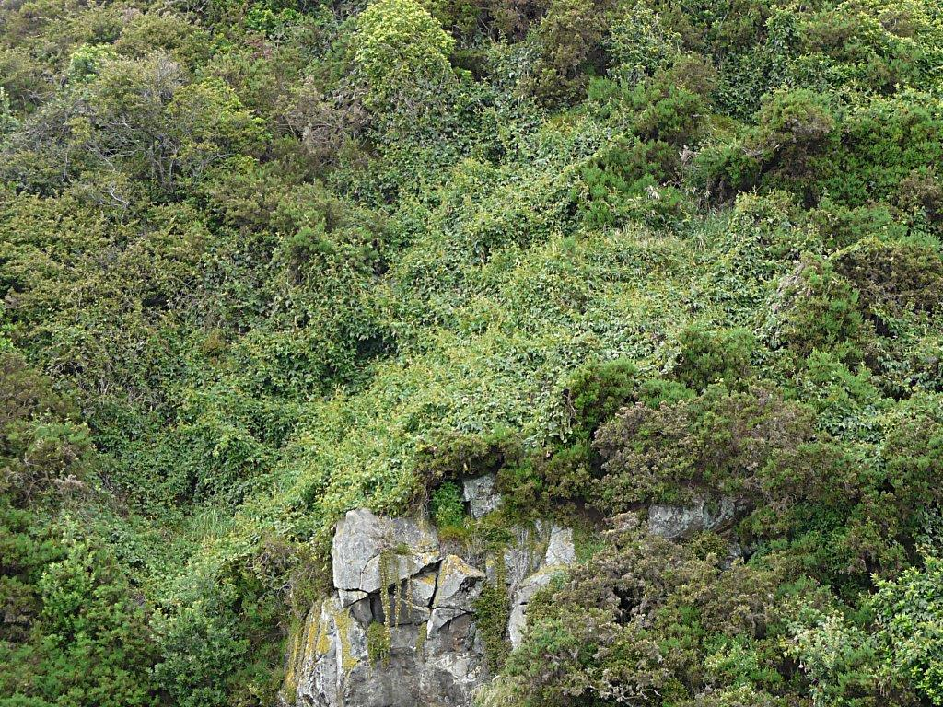
Flagship Site - Tata Peninsula
The coastal slopes were infested with Banana passion vine and Old man’s beard.
The land is owned by Tasman District Council and QEII Trust.
In 2014 /15 Project De-Vine cleared it of mature vines
2016 onwards keeping the seedlings under control
Now three years of funded weed control work has followed in the wider Ligar Bay to Tata area, with another three years approved in 2021 from Wainui to Pohara.

Slide 20
Funding a wider area
Use the flagship site, to demonstrate the difference that can be made.
Find a source of funding to carry out an assessment of the wider area.
Notes:
Use the flagship site to demonstrate the difference that can be made to secure a source of funding to carry out an assessment of the wider area. This is usually charitable funding or funded from the surpus from contract work.

Slide 21
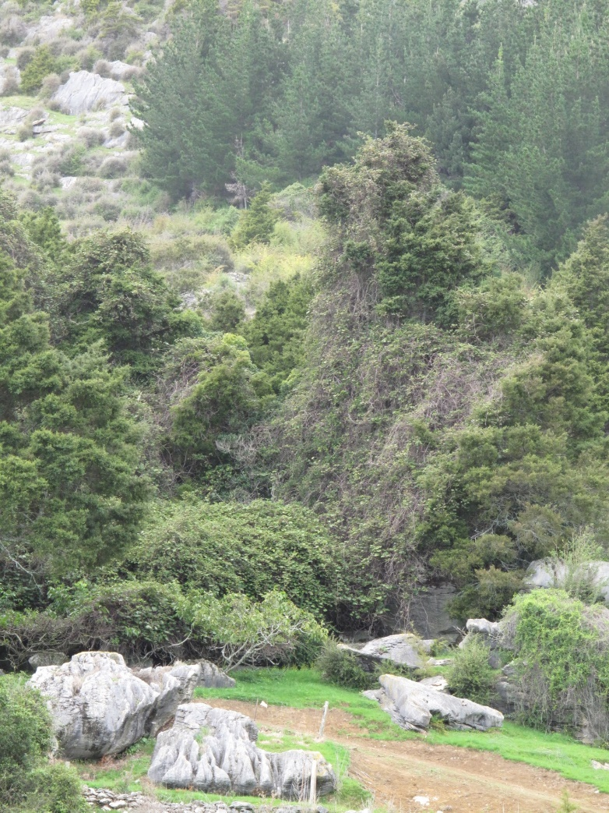
Knockdown
Our funders are usually Department of Conservation Community Fund & Lotteries.
Since 2017, we have been working with the Tasman Environmental Trust administered Cobb Mitigation Fund to carry out assessments and act as a secured funder to attract other funders.
Notes:
Knockdown
Following assessment we move into knockdown.
Our main funders are usually DOC Community Fund & Lotteries
Lotteries require secured funders to cover 1/3rd of the project cost.
A partnership with Tasman Environmental Trust to use the Cobb Mitigation Fund for secured funding has enabled us to receive our latest grant, with a 3-year project budget of $150k, to carry our control work in the lower Takaka Valley.

Slide 22
Assessments leading to funded control work – Spreading up the Takaka Valley, west to Collingwood & onto Pakawau, & returning east from Pohara to Wainui
In 2017 Tasman Environmental Trust (Cobb Mitigation Fund {CMF}) funded a survey of the lower Takaka valley (MU-D6). This led to successful control funding for 3 years with Lotteries and the CM Fund. 87 larger properties assessed out of 434.
In 2018 Golden Bay Community Trust funded an assessment of the area from the Takaka River towards Onekaka (MU-C1). This led to successful control funding for 3 years with the DOC Community Fund in 2020, WWF (One year in 2019) and other sources. 61 larger properties assessed out of 217 properties.
In 2019 Tasman Environmental Trust (Cobb Mitigation Fund {CMF}) funded a survey of the middle Takaka valley (MU-E & MU-G1). This led to successful control funding for 3 years in 2020 with the CM Fund and other sources. 110 larger properties assessed out of 142.
In 2020 StreamCare funded, with a Aorere River prize, a survey of the area from Onekaka to just before Collingwood (MU-C2) and the Aorere valley, including Collingwood, onto Pakawau (MU-B). This led to successful control funding for 3 years in 2021 with the Jobs for Nature Community Conservation Fund and other sources. Over 224 mixed properties assessed out of 767.
Our previous work in Wainui to Pohara with multiple funders from 2013 to 2019 has created a clear picture of the work still needed there to control the last of the large properties that we never completely controlled and control a wider range of plants to a higher degree to include Climbing asparagus & others, as well as Banana passion vine and Old mans beard. This led to successful control funding for 3 years in 2021 with the Jobs for Nature Community Conservation Fund. 219 mixed properties assessed out of 321.
Notes:
Assessment – Takaka River Onekaka
Golden Bay Community Trust and Tasman Environmental Trust are funding assessment of the area from the Takaka River towards Onekaka.
The current area being assessed involves 220 properties, but 65 are more than 8ha and occupy 94% of the area.
Drones help us with hard to see areas.
We will add in smaller properties with known infestations – eg Climbing asparagus to be sure the outer limit of its spread is discovered.

Slide 23
Control work - Takaka Hill & Riwaka to Marahau
In 2017 to 2019 NZ Transit contracted us to carry out control work of Old mans beard and Banana passion vines alongside State Highway 60 on both sides of the Takaka Hill. This stopped with the large slips which are still being repaired. We hope to resume the control work in 2022.
In 2018 Assessments funded by Project Janzoon and TDC has led to control work starting in 2019 for 3 years to start to clear this area of Old man’s beard, Banana passion vines and wilding Douglas Fir. This will complete the ’halo’ around Abel Tasman National Park for the initial knockdown of these vines.
Notes:
Assessment - Takaka Hill & Riwaka to Marahau
Planning with Janszoon and TDC to assess and apply for funding to clear this area of OMB and BPV. This will complete the “halo” around ATNP for the initial knockdown of these vines.
We have had an offer of free helcopter time for assessment work in this area following our flagship work on Takaka Hill.
Have submitted for Riwaka to Marahau to be an area of “Progressive Control” for Banana Passion vine and Old man’s beard at the current RPMS/RPMP review

Slide 24
Follow up knock down phase with ongoing control. Our funder for this crucial phase is primarily the Rata Foundation. We run working bees, in various stages, to activate the local owners in many ongoing control sites.
Ongoing control
Notes:
Ongoing control
Follow up control work in the fourth or fifth year and then again two to three years later. Our funder for this crucial phase is primarily the Rata Foundation.
We have successfully run working bees to activate the local owners in many ongoing control sites.

Slide 25
Reporting
A key part of our work is reporting to landowners and funders .
Our simplest reporting is adding pest plants or trees killed per species per property. This can be sent to landowners in reports. When added for all the properties in a funded area & then added for all the work areas, the numbers before very impressive.
We report to funders and landowners on 4 phases of control.
Phase | Name: | Description
P1 | Initial weed control | Dense mature canopy or understorey of mature and younger fruiting/seeding pest plants with juvenile pest plants (not yet fruiting / seeding). Forest canopy or understorey smothered by pest plants. 1-2 visits per property over 1-2 years
P2 | Follow-up weed control | Some mature pest plants present. Majority of pest plants are juvenile (not yet fruiting). 1 visit per property over 1 year
P3 | Seedbank control | No mature pest plants present. Low density of juvenile pest plants / seedlings visible. 1 visit per property approx. every 2 years for 4-6 years
P4 | Long-term maintenance control | No mature pest plants present. Very low density and distribution of juvenile pest plants / seedlings visible. Bi or Tri-annual visit per property. On-going.
Notes:
Reporting to Funders and Landowners
A key part of our work is reporting back to funders and land owners. We report to land owners on the numbers of pest plants killed and on the phase of control that properties are in.

Slide 27
Tables showing the before and after “phase” status of BPV, OMB and CAS on all properties in Ligar Bay to Tata with 3 years of weed control work
MU-D4 Phase Start Summary 2019
Summary table hectares | Column1 | BPV | BPV% | OMB | OMB% | IJA | WNS | CAS | CAS% | Pampas | W Pine | Jap HS
Phase 1 |  | 115.85 | 69.04% | 23.19 | 50.70% | 0.00 | 0.00 | 15.32 | 99.60% | 0.00 | 0.00 | 0.00
Phase 2 |  | 46.76 | 27.87% | 11.66 | 25.50% | 0.00 | 0.00 | 0.06 | 0.40% | 0.00 | 0.00 | 0.00
Phase 3 |  | 5.18 | 3.09% | 10.89 | 23.80% | 0.00 | 0.00 | 0.00 | 0.00% | 0.00 | 0.00 | 0.00
Phase 4 |  | 0.00 | 0.00% | 0.00 | 0.00% | 0.00 | 0.00 | 0.00 | 0.00% | 0.00 | 0.00 | 0.00
Total ha |  | 167.80 |  | 45.73 |  | 0.00 | 0.00 | 15.38 |  | 0.00 | 0.00 | 0.00
% ha of the MU properties assessed |  | 36.00 |  | 7.02 |  | 0.00 | 0.00 | 3.40 |  | 0.00 | 0.00 | 0.00
Total assessed to date | 110
Number of properties clear of species | 72 | 74 |  | 92 |  |  |  | 97
Number of properties with species | 38 | 36 |  | 18 |  |  |  | 13
Total of 391.42 ha on 38 properties | 391.42
MU-D4 Phase Finish Summary 2019
Summary table hectares | Column1 | BPV | BPV% | OMB | OMB% | IJA | WNS | CAS | CAS% | Pampas | W Pine | Jap HS
Phase 1 |  | 63.10 | 42.99% | 11.24 | 25.12% | 0.00 | 0.00 | 0.74 | 4.74% | 0.00 | 0.00 | 0.00
Phase 2 |  | 56.71 | 38.64% | 14.51 | 32.42% | 0.00 | 0.00 | 11.98 | 76.67% | 0.00 | 0.00 | 0.00
Phase 3 |  | 26.96 | 18.37% | 14.50 | 32.40% | 0.00 | 0.00 | 2.74 | 17.56% | 0.00 | 0.00 | 0.00
Phase 4 |  | 0.00 | 0.00% | 4.50 | 10.06% | 0.00 | 0.00 | 0.16 | 1.04% | 0.00 | 0.00 | 0.00
Total ha |  | 146.77 |  | 44.74 |  | 0.00 | 0.00 | 15.63 |  | 0.00 | 0.00 | 0.00
% ha of the MU properties assessed |  | 68.00 |  | 5.80 |  | 0.00 | 0.00 | 1.88 |  | 0.00 | 0.00 | 0.00
Total assessed to date | 102
Number of properties clear of species | 71 | 71 |  | 87 |  |  |  | 90
Number of properties with species | 31 | 31 |  | 15 |  |  |  | 12
Total of 237.47 ha on 31 properties | 237.47

Slide 28
Graphs showing the before and after “phase” status of BPV, OMB and CAS on all properties in Ligar Bay to Tata with 3 years of weed control work

Slide 29
MU-D4 - Ligar Bay to Tata areas under varying control involving properties of >1200m2
START- MU-D4 - Ligar Bay areas under varying control involving properties of >1200m2
MU-D4 | Chart headings along horizontal axis | Number of properties. They can be listed in more than one row | Hectares | Comments
Area receiving control work | Controlled | 33 | 146.88
Area assumed or known to be clear | Clear | 73 | 147.38 | Includes 90% of Donald Sutton's land which is planted with Manuka and Redwoods.
Area still to be controlled – subject to funding limits with permission | Still to control | 3 | 109.96 | Includes 100% of John Stevens’ and Duncan MacFarlane's + Includes 10% of Donald Sutton's
Area still to be controlled with no permission from landowner | No permission | 1 | 44.33 | Tata Headland 100% no control allowed of BPV by owners.
Total area in MU (all properties of >1200m2) |  |  | 448.55 | This should come from the TDC property list and be the same as the total of the 4 other rows.
FINISH MU-D4 - Ligar Bay areas under varying control involving properties of >1200m2
MU-D4 | Chart headings along horizontal axis | Number of properties. They can be listed in more than one row | Hectares | Comments
Area receiving control work | Controlled | 37 | 185.42 | Includes 10% of Donald Suttons land, 30% of John Stevens and 20% of Tata Headland
Area assumed or known to be clear | Clear | 71 | 145.1 | Includes 90% of Donald Suttons land which is planted with Manuka and Redwoods.
Area still to be controlled – subject to funding limits with permission | Still to control | 2 | 82.55 | Includes 70% of John Stevens’ land and 100%of Duncan McFarlanes’ (due to a lack of track access)
Area still to be controlled with no permission from landowner | No permission | 1 | 35.46 | Tata Headland 80% no control allowed of BPV by owners.
Total area in MU (all properties of >1200m2) |  |  | 448.53 | This should come from the TDC property list and be the same as the total of the 4 other rows.

Slide 30
MU-D1 Graph of 4 properties Banana Passion Vine seedling count on Rocklands Road 2010 to June 2021

Slide 31
Weeds Mapping
PDVET has invested in a new mapping system to streamline our reporting and save on manual data entry time.
This is built on ARCGIS.
GeoInsight – Blenheim, Rob Besaans and Berit Mohr, have built this for PDVET.
The mapping system will allow our staff to track in real time all their movements on a property.
They can add weed points and areas, hazards, points of interest or any information that may be required to report on, or for future visits.
We can flag a property as requiring attention

Slide 32
We can attach photos and files to a property or a project.
We can enter timesheets for a property and control sheets, which update the number of pest plants/weeds removed from the property.
We can use a live version of the map or we can use an offline version.
We can update our team about a property from the office with any information they may need – owner contact details etc.
All of this information updates our three dashboards.
From the office we can extract data as required to create reports for land owners and funders.

Slide 33
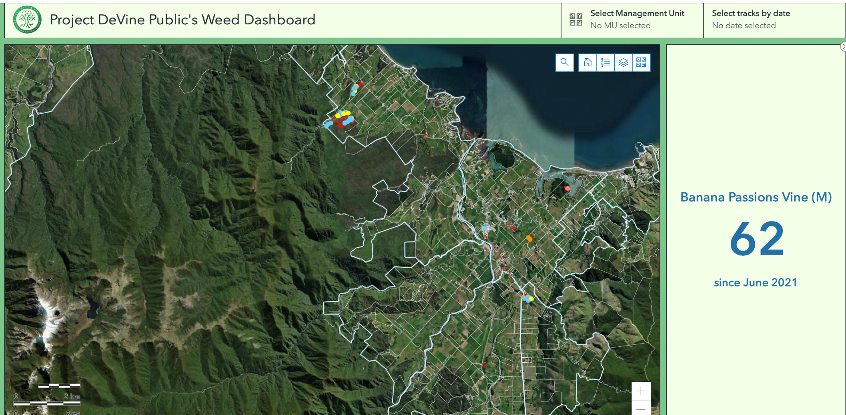
We have embedded a basic view of the map on our website, along with a weeds numbers graph for the public to view.
The viewer can click on a map or select a Management unit and the information will be highlighted.

Slide 34
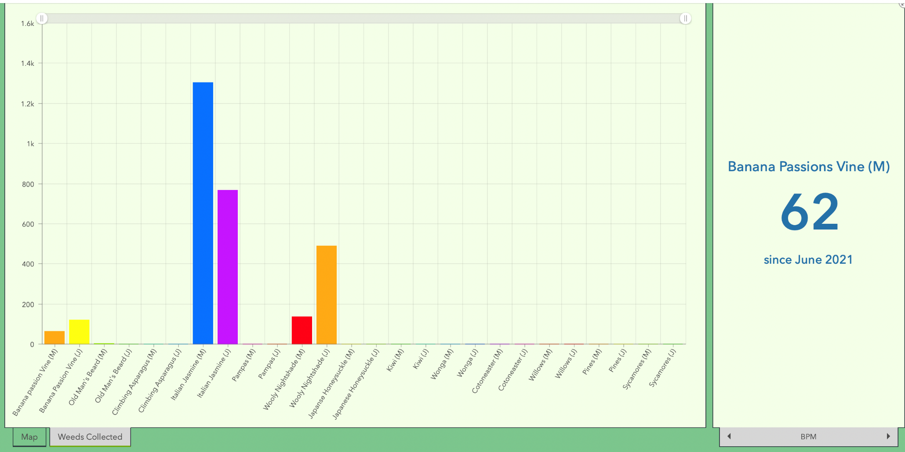
The user can select weeds collected and a graph is shown of all the weeds/pest plants we have collected. They can also toggle through the individual weeds/pest plants on the right side of the screen.

Slide 35
From our private dashboard we can run queries – these can range from track lines for a project/property/Management Unit through to time sheets, how many hours were worked on a property or a project.
We can select a property and show all the track lines for that property, as well as any weed points/areas. A PDF is created and this can be attached to the report to the property owner or to the funder if part of a bigger project.
We can see what properties are flagged for requiring attention and what needs to be done.
There are endless possibilities for how this mapping system can be used. It will grow, as we do.

Slide 39
Some statistics
Number of vines and other pest plants and trees killed manually has passed 1,000,000. Including 656,000 Banana passion vines and 104,000 Old mans beard vines
Over 700 properties have been assessed. Control work has been done on over 500 private properties
Properties mapping database used to store all tracks and data as well as work out properties to be visited.
Large number of properties go on to manage their own control work.
Involvement increases as pest plant infestation levels decrease.
June 2015 – Finalist in the Ministry of the Environment Awards – in the Community Leadership category.

Slide 40
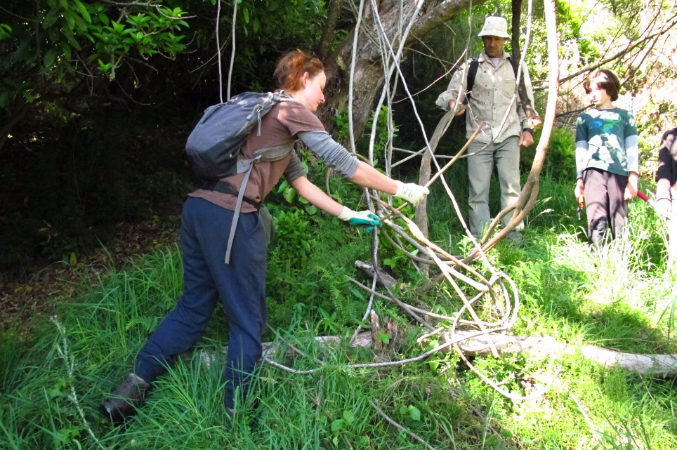
Neighbourhood Weedbusting groups
Neighbourhood Weedbusting groups encouraged and supported.
Sponsorship from Nelson Building Society and Cut’n’Paste supplying the gel bottles.
Approach local businesses to fund working bees.
Support outreach groups – eg Mountain bikers on Codgers track - Nelson, Motueka Valley and Marahau Residents Associations.
Notes:
Start Neighbourhood Weedbusting groups to encourage pest vine control work in areas where Project De-Vine does not have funding.
Funded by sponsorship from Nelson Building Society and Cut’n’Paste supplying the gel bottles.
Various local businesses fund individual working bees.
Support “outreach” groups to start – Mountain bikers working on Codgers track outside Nelson and Motueka Valley and Marahau Residents Associations.

Slide 41
Teaching plant identification to volunteers and staff

Slide 42
We count plant and tree species numbers per property and summate – to 31st July 2021
Banana passion vine: Mature: 196225, Juvenile: 460071 Total: 656296
Old man’s beard: 104116
Climbing asparagus: 18428
Woolly nightshade: 37912
Italian / yellow jasmine: 46148
Other less common control plants + wilding pines, sycamores (38562) & crack willows (3744): 172242
Total to date: 1,035,142

Slide 43
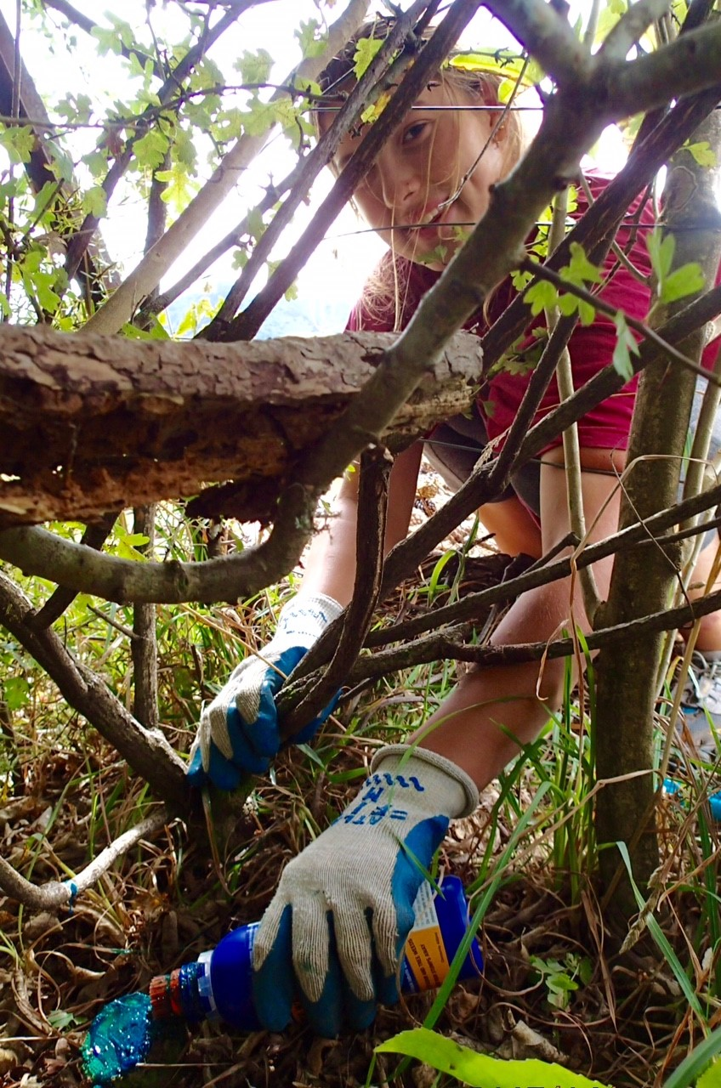
Environmental practice
Project De-Vine uses Glyphosate with the safe surfactant APG.
We grub out or provide an organic gel of acetic acid and salt from Cut’n’Paste, or other sources, for those not wanting to use chemicals.
Notes:
PDVT by choice uses Glyphosate with the safe surfactant APG.
These are found in AgPro Green for the liquid and Cut’n’Paste for the gel and other brands.
We have available an organic gel, from Cut’n’Paste, made with Acetic acid (vinegar) & salt for those not wanting to use chemicals. Several applications are often needed to kill the plant.

Slide 44
Project De-Vine participates in wider conservation initiatives for both Golden Bay (Project Mohua) and the top of the South Island (the Kotahitanga mō te Taiao Alliance of local government, central government and Iwi, who have developed a strategy from Kaikoura through to Buller).

Slide 45
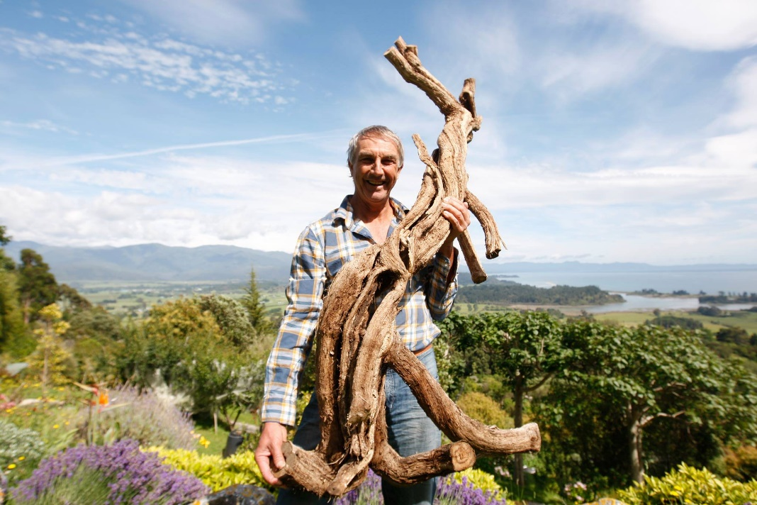
Thank you for your attention

Slide 46
Any questions?
Email us at admin@pdvet.org.nz

